Slide 1
Linear Data Structure UNIT -II

Slide 2
CONTENTS
2.1 Introductions
2.2 Linear Array
2.2.1 Linear Array Representations in Memory
2.2.2 Traversing, Insert, and Delete Algorithms
2.2.3 Binary Search Algorithm
2.3 Multidimensional Array
2.3.1 2-D Array
2.3.2 Representations in Memory
2.3.3 Inconsistency Matrix Algorithms

Slide 3
Introduction
Data Structure can be classified as:
linear
non-linear
Linear (elements arranged in sequential in memory location) i.e. array & linear link-list
Non-linear such as a tree and graph.
Operations:
Traversing, Searching, Inserting, Deleting, Sorting, Merging
Array is used to store a fix size for data and a link-list the data can be varies in size.

Slide 4
Introduction
Advantages of an Array:
a) Very simple
b) Economy – if full use of memory
c) Random accessed at the same time
Disadvantage: wasting memory if not fully used

Slide 5
Linear Array
Homogeneous data:
a) Elements are represented through indexes.
b) Elements are saved in sequential in memory locations.
Number of elements, N –> length or size of an array.
If:
UB : upper bound ( the largest index)
LB : lower bound (the smallest index)
Then: N = UB – LB + 1
Length = N = UB when LB = 1

Slide 6
Linear Array
All elements in A are written symbolically as, 1 .. n is the subscript.
A1, A2, A3, .... , An
i.e., FORTRAN, PL/1 and BASIC → A(1), A(2), ..., A(N)
Java → A[0], A[1], ..., A[N-1] , subscript starts from 0
LB = 0, UB = N–1

Slide 7
Representation of Array in a Memory
The process to determine the address in a memory:
a) First address – base address.
b) Relative address to base address through index function.
Example: char X[100];
Let char uses 1 location storage.
If the base address is 1200 then the next element is in 1201.
Index Function is written as:
Loc (X[i]) = Loc(X[0]) + i , i is subscript and LB = 0
1200 1201 1202 1203
X[0] X[1] X[2]

Slide 8
Representation of Array in a Memory
In general, index function:
Loc (X[i]) = Loc(X[LB]) + w*(i-LB);
where w is length of memory location required.
For real number: 4 byte, integer: 2 byte and character: 1 byte.
Example:
If LB = 5, Loc(X[LB]) = 1200, and w = 4, find Loc(X[8]) ? Loc(X[8])= Loc(X[5]) + 4*(8 – 5)
= 1212

Slide 9
Traversing Algorithm
Traversing operation means visit every element once.
e.g. to print, etc.
Example algorithm:
[Assign counter]
K=LB // LB = 0
2. Repeat step 2.1 and 2.2 while K <= UB // If LB = 0
2.1 [visit element]
do PROCESS on LA[K]
2.2 [add counter]
K=K+1
3. end repeat step 2
4. exit

Slide 10
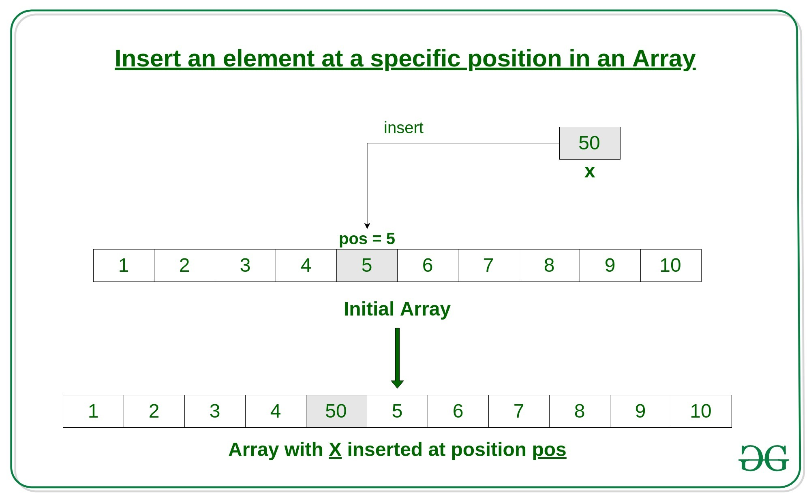
Insertion Algorithm
Insert item at the back is easy if there is a space. Insert item in the middle requires the movement of all elements to the right as in Figure 1.

Slide 11
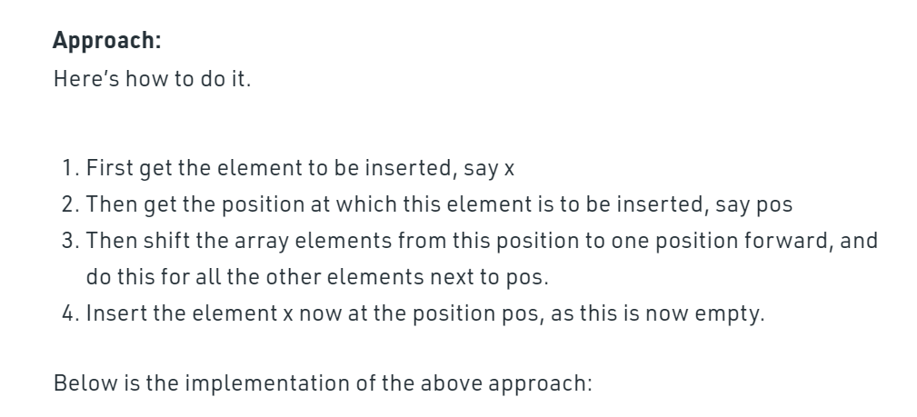
Insertion Algorithm
Insert item at the back is easy if there is a space. Insert item in the middle requires the movement of all elements to the right as in Figure 1.

Slide 12
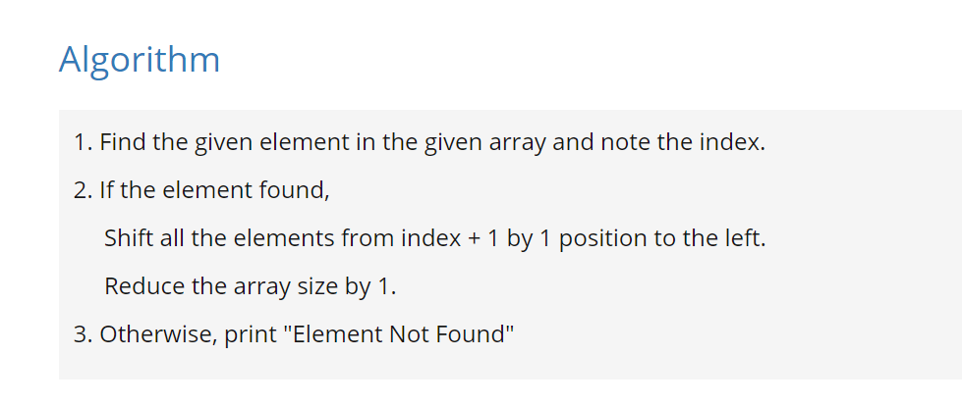
Deletion Algorithm
Deleting an element does not affect the size of array.
It is also checked whether deletion is possible or not.

Slide 13
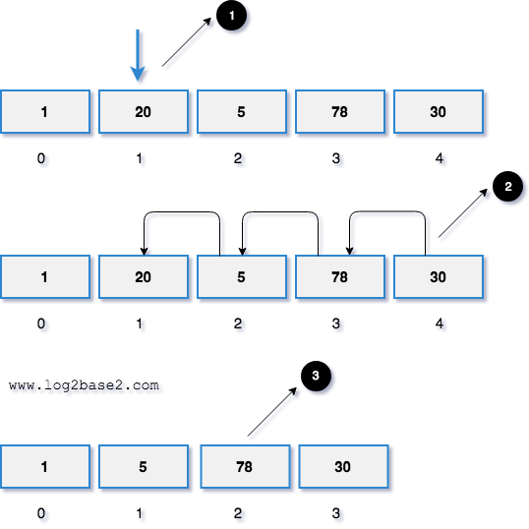
Deletion Algorithm
Visual Representation
Let's take an array of 5 elements.
1, 20, 5, 78, 30.
If we remove element 20 from the array, the execution will be,

Slide 14
MULTIDIMENSIONAL ARRAY
Two or more subscripts.

Slide 15
2-D ARRAY
A 2-D array, A with m X n elements.
In math application it is called matrix.
In business application – table.
Example:
Assume 25 students had taken 4 tests.
The marks are stored in 25 X 4 array locations:
 |  | U0 | U1 | U2 | U3
Stud 0 |  | 88 | 78 | 66 | 89
Stud 1 |  | 60 | 70 | 88 | 90
Stud 2 |  | 62 | 45 | 78 | 88
.. |  | .. | .. | .. | ..
.. |  | .. | .. | .. | ..
Stud 24 |  | 78 | 88 | 98 | 67
m
n

Slide 16
2-D ARRAY
Multidimensional array declaration in Java:-
int [][] StudentMarks = new int [25][4];
StudentMarks[0][0] = 88;
StudentMarks[0][1] = 78;…..
OR
int [][] StudentMarks = {{88, 78, 66, 89},
{60, 70, 88, 90},…}

Slide 17
2-D ARRAY
the 2-D array is visualized as follows:
StudentMarks
[0]
[1]
[2]
[3]
…
88 | 78 | 66 | 89
[0]
[1]
60 | 70 | 88 | 90
[2]
62 | 45 | 78 | 88
[3]
[4]
[5]
[6]
[24]

Slide 18
Higher-Dimensional Arrays
An array can be declared with multiple dimensions.
2 Dimensional 3 Dimensional
double Coord[100][100][100];
Multiple dimensions get difficult to visualize graphically.
•

Slide 19
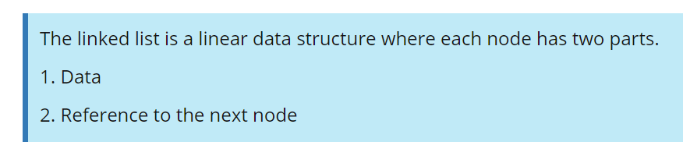
Linked List

Slide 20
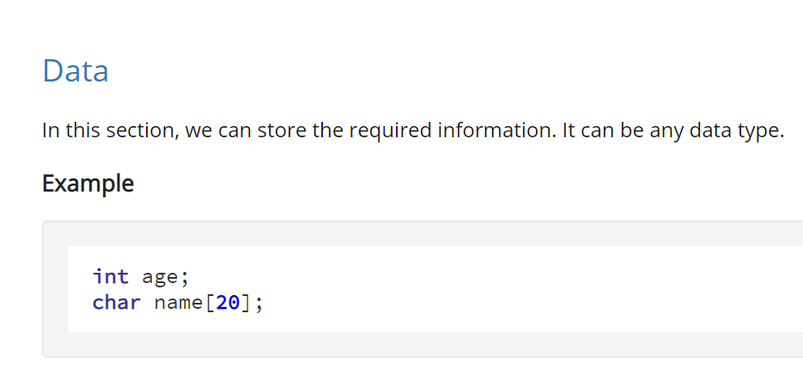
Linked List

Slide 21
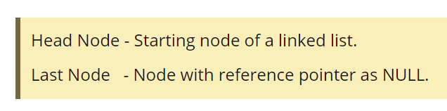
Linked List
Reference to the next node
It will hold the next nodes address.

Slide 22
Linked List
Selecting a data type for the linked list
As we discussed earlier, each node in a linked list has two parts.
Data - it can be any data type. int,char,float,double etc.
Reference Part - It will hold the address of the next node. So, it is a type pointer.

Slide 23
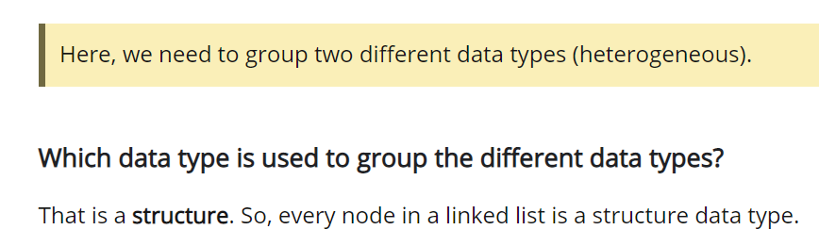
Linked List
Selecting a data type for the linked list
Data - it can be any data type. int,char,float,double etc.
Reference Part - It will hold the address of the next node. So, it is a type pointer.

Slide 24
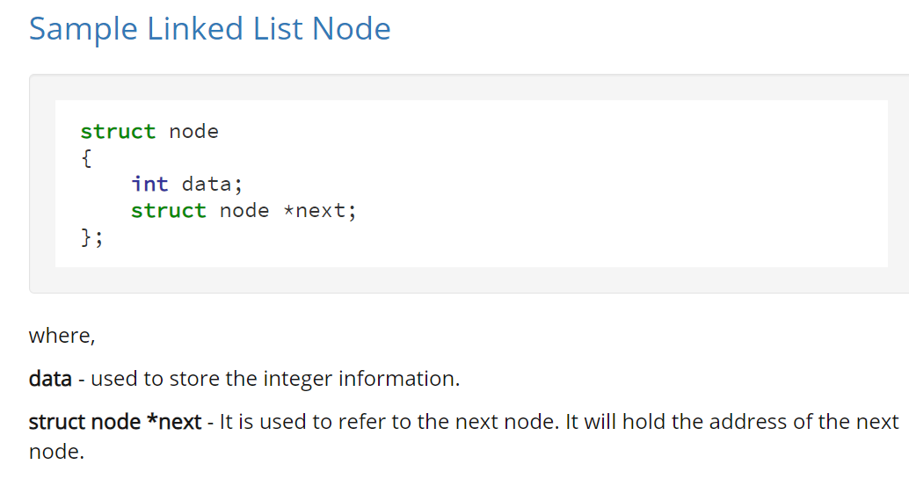
Linked List

Slide 25

Linked List

Slide 26
Linked List
Let's create and allocate memory for 3 nodes
struct node
{
int data;
struct node *next;
};
struct node *head,*middle,*last;
head = malloc(sizeof(struct node));
middle = malloc(sizeof(struct node));
last = malloc(sizeof(struct node));

Slide 27
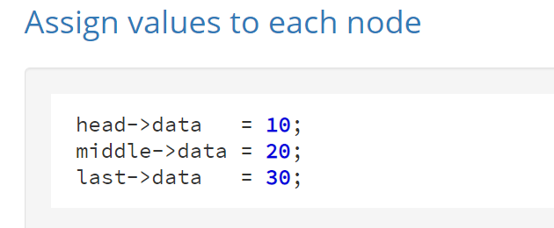
Linked List

Slide 28
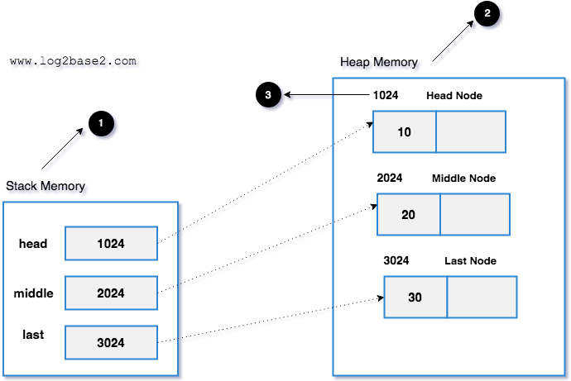
Linked List

Slide 29
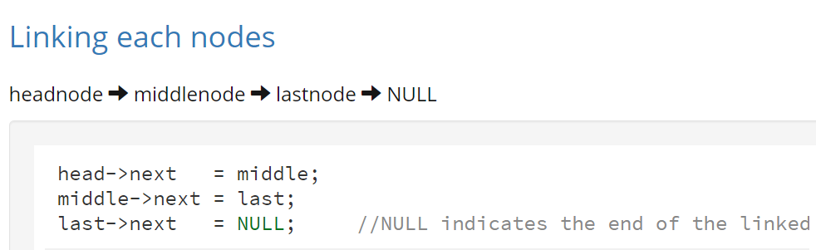
Linked List

Slide 30
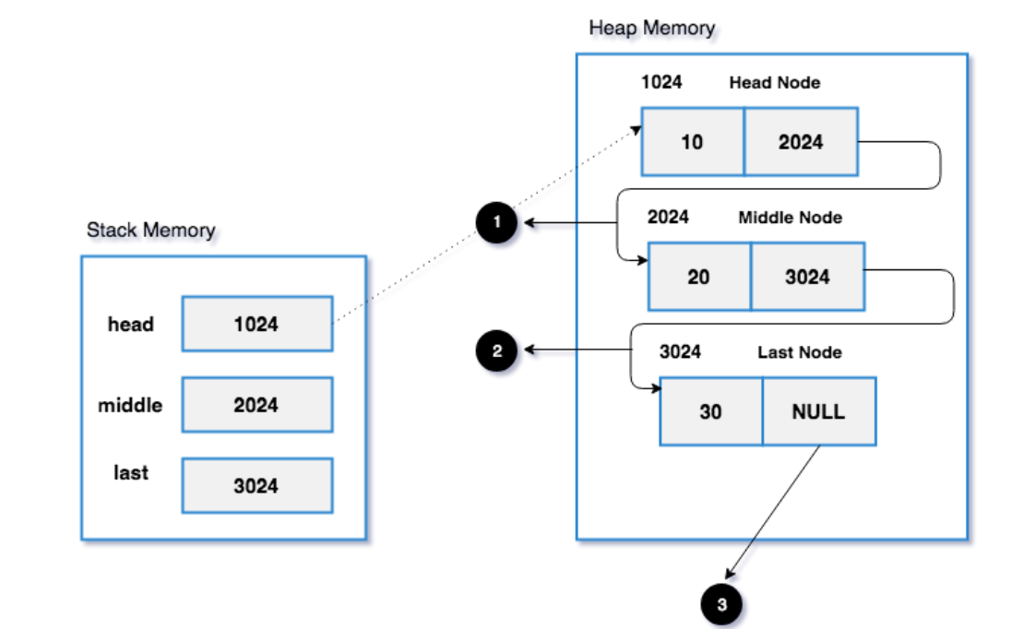
Linked List

Slide 31
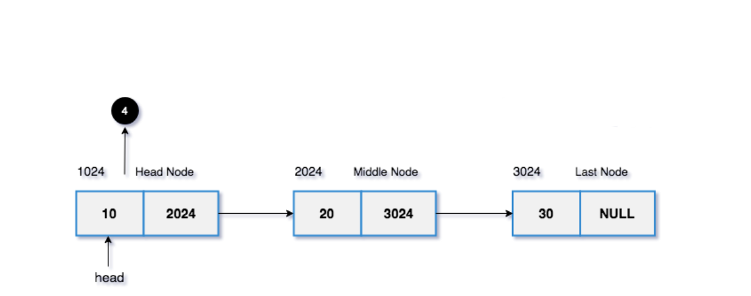
Linked List

Slide 32
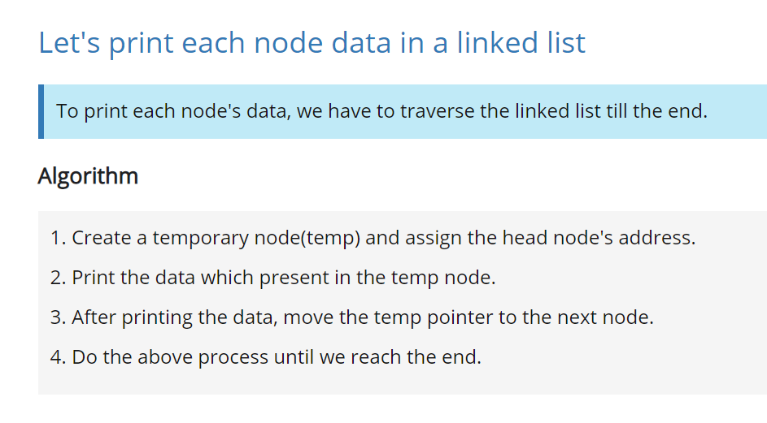
Linked List: Traversal

Slide 33
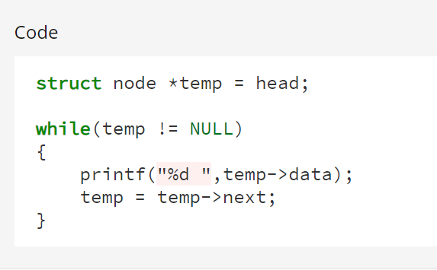
Linked List: Traversal

Slide 34
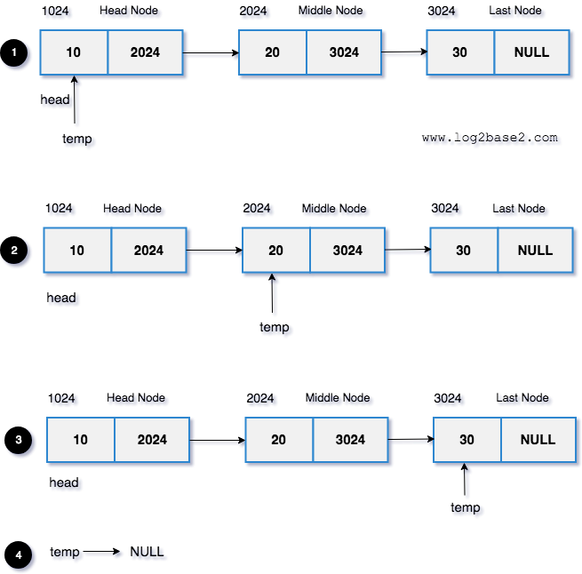
Linked List: Traversal

Slide 35
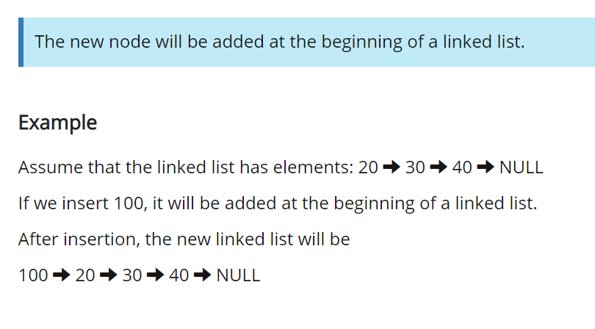
Linked List: Inserting a node at the beg
Inserting a node at the beginning of a linked list

Slide 36
Linked List: Inserting a node at the beg
Inserting a node at the beginning of a linked list
Algorithm
Create a new node with the given data.
Make the new node points to the head node.
Finally, make the new node as the head node.

Slide 37
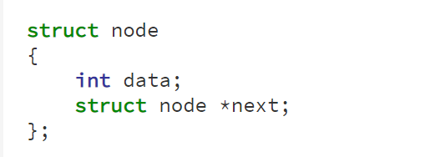
Linked List: Inserting a node at the beg
Inserting a node at the beginning of a linked list
1

Slide 38
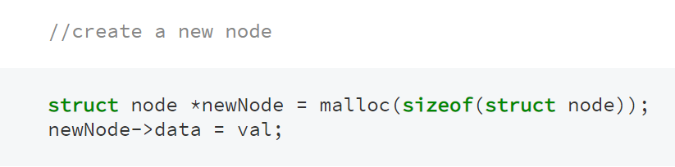
Linked List:Inserting a node at the beg
Inserting a node at the beginning of a linked list
2

Slide 39
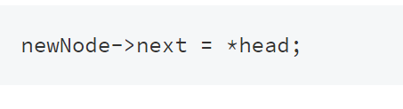
Linked List: Inserting a node at the beg
Inserting a node at the beginning of a linked list
3

Slide 40

Linked List: Inserting a node at the beg
Inserting a node at the beginning of a linked list
4

Slide 41
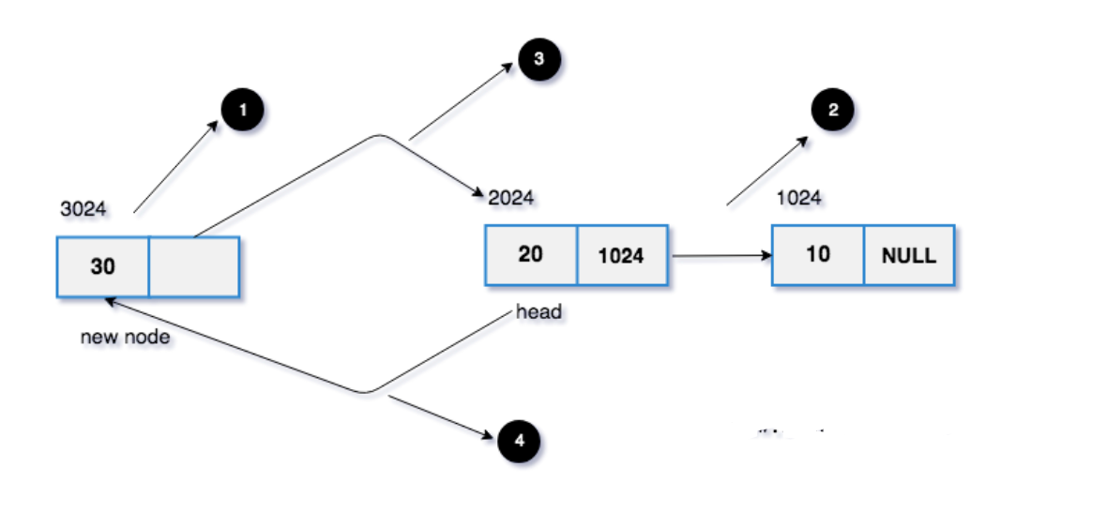
Linked List: Inserting a node at the beg
Inserting a node at the beginning of a linked list

Slide 42

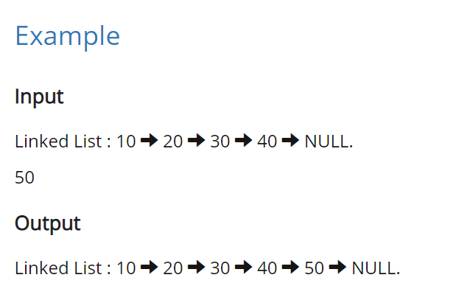
Linked List: Inserting a node at the End

Slide 43

Linked List: Inserting a node at the End
1. Create a new node with the given data.
And make the new node => next as NULL. (Because the new node is going to be the last node.)
2. If the head node is NULL (Empty Linked List),
make the new node as the head.
3. If the head node is not null, (Linked list already has some elements),
find the last node.
make the last node => next as the new node.

Slide 44
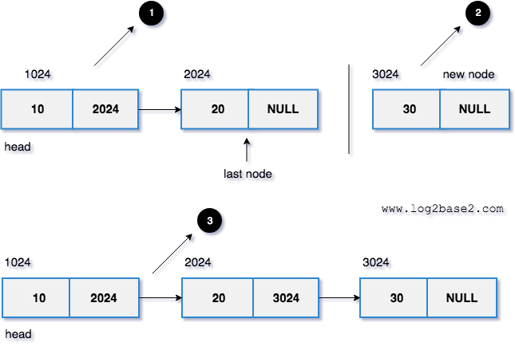
Linked List: Inserting a node at the End

Slide 45
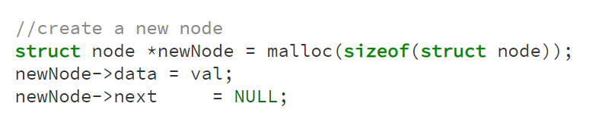
Linked List: Inserting a node at the End

Slide 46
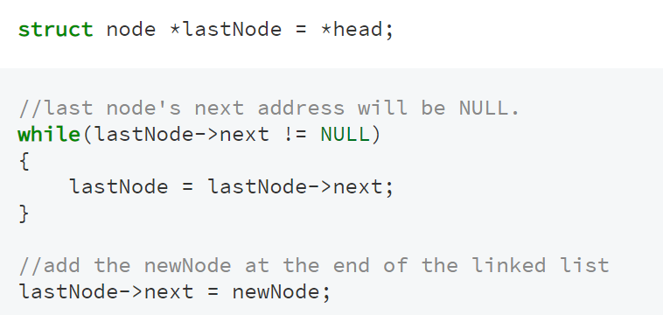
Linked List: Inserting a node at the End
Temp
Temp
Temp
Temp
Temp

Slide 47

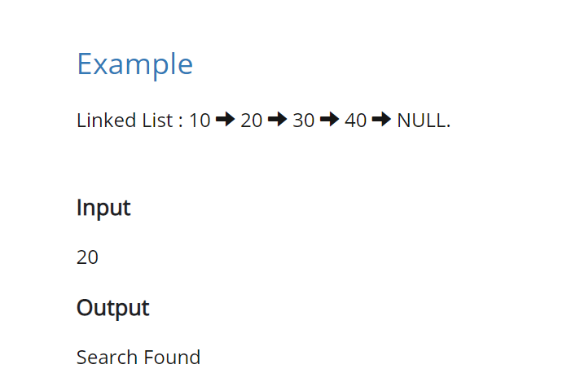
Linked List: Searching a node in singly linked list

Slide 48
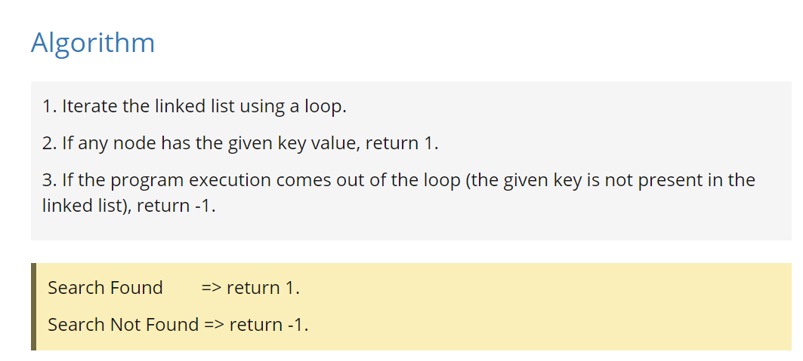
Linked List: Searching a node in singly linked list

Slide 49
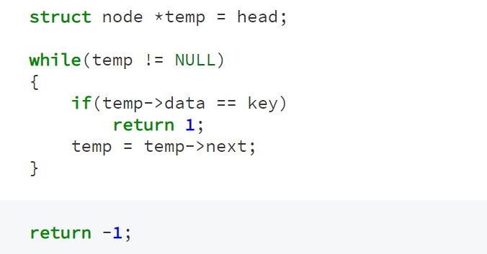
Linked List: Searching a node in singly linked list

Slide 50

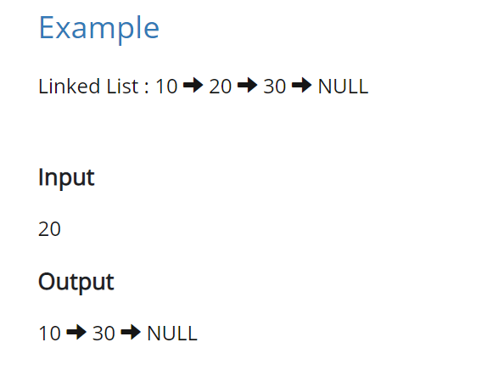
Linked List: Deleting a node in linked list

Slide 51
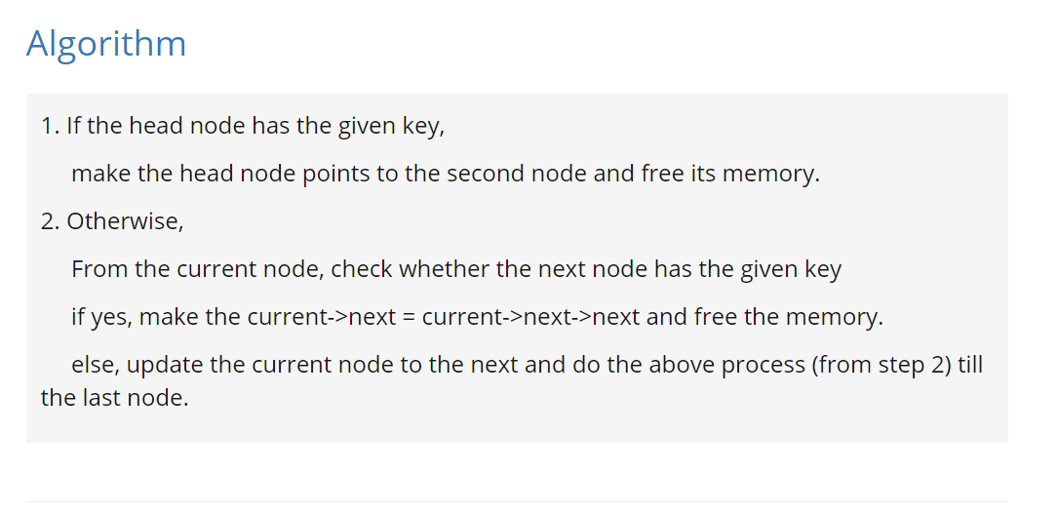
Linked List: Deleting a node in linked list

Slide 52
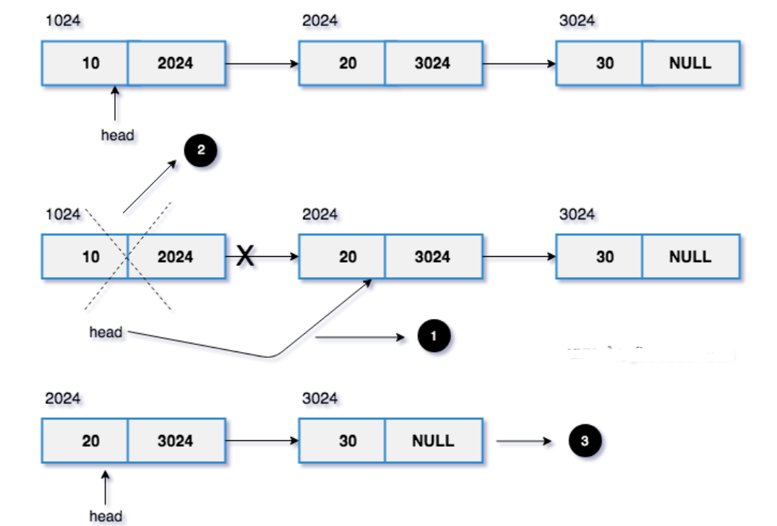
Linked List: Deleting a node in linked list

Slide 53
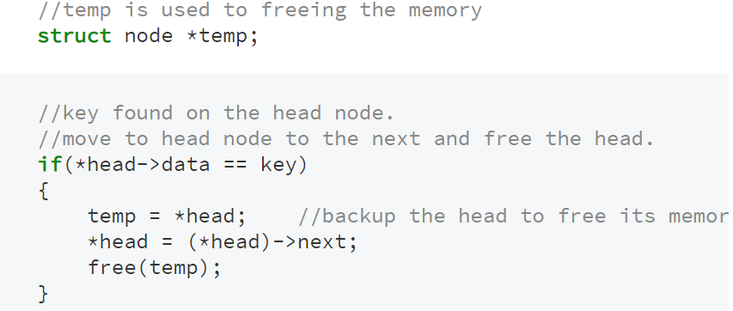
Linked List: Deleting a node in linked list

Slide 54
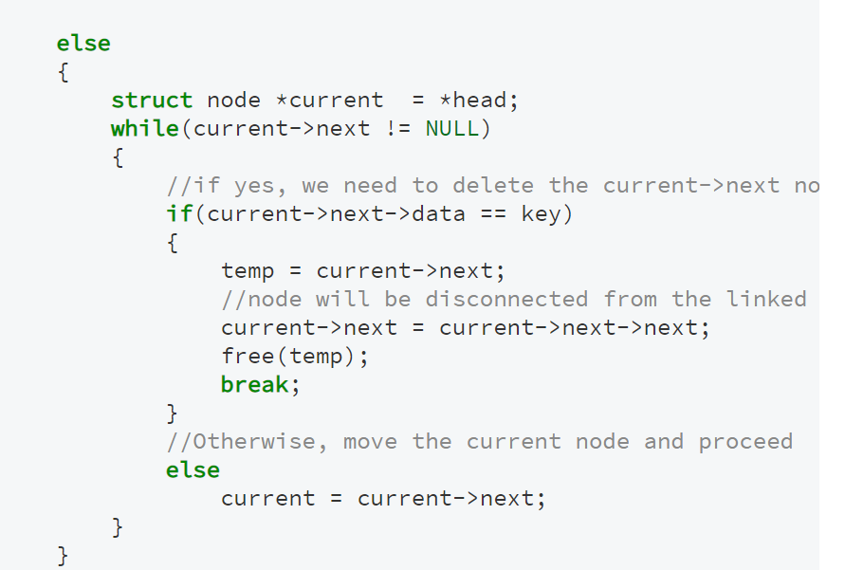
Linked List: Deleting a node in linked list

Slide 55
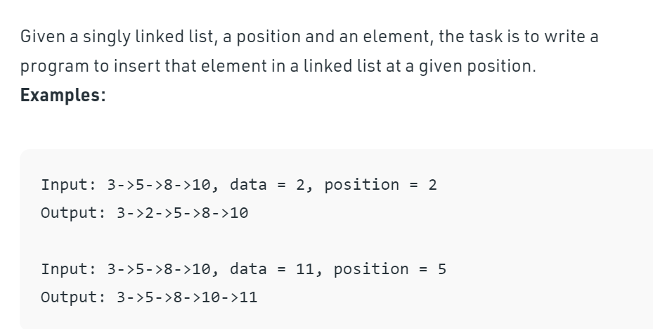
Linked List: Insert a node at a specific position

Slide 56
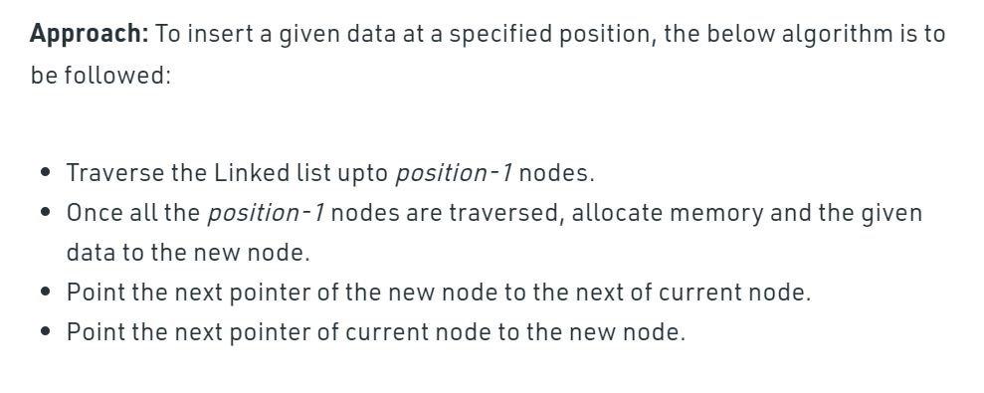
Linked List: Insert a node at a specific position

Slide 57
Linked List: Insert a node at a specific position
Insert EAT into an ordered linked list
head
previous
previous
BAT
3
CAT
CAT
4
8
6
FAT
0
curr
curr
curr
EAT
EAT
4
a
03 curr = head;
04 while (curr != NULL)
05 {
06 if (curr->data >= value)
07 {
08 Struct node *a = malloc(Sizeof( Struct node));
09 a->next = curr;
10 previous->next = a;
11 break;
12 }
13 previous = curr;
14 curr = curr->next;
15 }

Slide 58
Linked List
Uses of Linked List
The list is not required to be contiguously present in the memory. The node can reside any where in the memory and linked together to make a list. This achieves optimized utilization of space.
list size is limited to the memory size and doesn't need to be declared in advance.
Empty node can not be present in the linked list.
We can store values of primitive types or objects in the singly linked list.

Slide 59
Linked List
Array contains following limitations:
The size of array must be known in advance before using it in the program.
Increasing size of the array is a time taking process. It is almost impossible to expand the size of the array at run time.
All the elements in the array need to be contiguously stored in the memory. Inserting any element in the array needs shifting of all its predecessors.
Linked list is the data structure which can overcome all the limitations of an array. Using linked list is useful because,
It allocates the memory dynamically. All the nodes of linked list are non-contiguously stored in the memory and linked together with the help of pointers.
Sizing is no longer a problem since we do not need to define its size at the time of declaration. List grows as per the program's demand and limited to the available memory space.

Slide 60
Linked List
Program for SLL

Slide 61
Doubly linked list

Slide 62
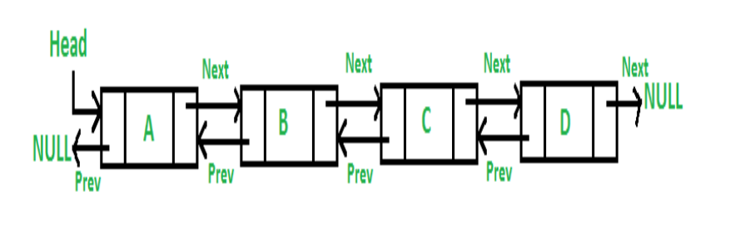
Introduction:DLL
Doubly linked list
A Doubly Linked List (DLL) contains an extra pointer, typically called previous pointer, together with next pointer and data which are there in singly linked list.

Slide 63
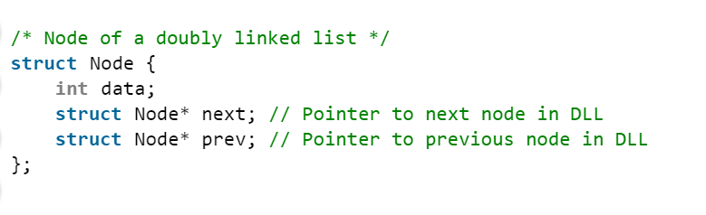
Introduction: DLL

Slide 64
Doubly Linked List (DLL)
Advantages over singly linked list 1) A DLL can be traversed in both forward and backward direction. 2) The delete operation in DLL is more efficient if pointer to the node to be deleted is given. 3) We can quickly insert a new node before a given node. In singly linked list, to delete a node, pointer to the previous node is needed. To get this previous node, sometimes the list is traversed. In DLL, we can get the previous node using previous pointer.

Slide 65
Doubly Linked List (DLL)
Disadvantages over singly linked list 1) Every node of DLL Require extra space for an previous pointer.
2) All operations require an extra pointer previous to be maintained.
For example, in insertion, we need to modify previous pointers together with next pointers.

Slide 66
Doubly Linked List (DLL)
SN | Operation | Description
1 | Insertion at beginning | Adding the node into the linked list at beginning.
2 | Insertion at end | Adding the node into the linked list to the end.
3 | Insertion after specified node | Adding the node into the linked list after the specified node.
4 | Deletion at beginning | Removing the node from beginning of the list
5 | Deletion at the end | Removing the node from end of the list.
6 | Deletion of the node having given data | Removing the node which is present just after the node containing the given data.
7 | Searching | Comparing each node data with the item to be searched and return the location of the item in the list if the item found else return null.
8 | Traversing | Visiting each node of the list at least once in order to perform some specific operation like searching, sorting, display, etc.

Slide 67
Doubly Linked List (DLL)
Program DLL

Slide 68

Circular Linked List

Slide 69
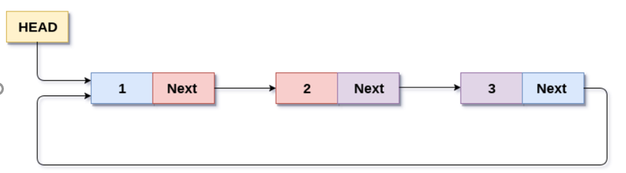
Circular Linked Lists
Circular Singly Linked List
In a circular Singly linked list, the last node of the list contains a pointer to the first node of the list. We can have circular singly linked list as well as circular doubly linked list.
We traverse a circular singly linked list until we reach the same node where we started. The circular singly liked list has no beginning and no ending. There is no null value present in the next part of any of the nodes.
The following image shows a circular singly linked list.

Slide 70
Circular Linked Lists
Circular Singly Linked List
In a circular Singly linked list, the last node of the list contains a pointer to the first node of the list. We can have circular singly linked list as well as circular doubly linked list.
We traverse a circular singly linked list until we reach the same node where we started. The circular singly liked list has no beginning and no ending. There is no null value present in the next part of any of the nodes.
The following image shows a circular singly linked list.

Slide 71
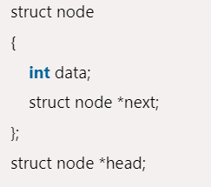
Circular Linked Lists

Slide 72
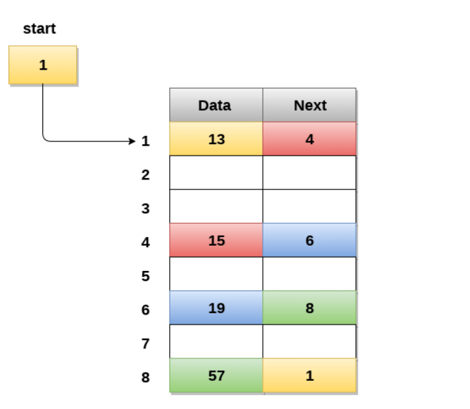
Circular Linked Lists

Slide 73
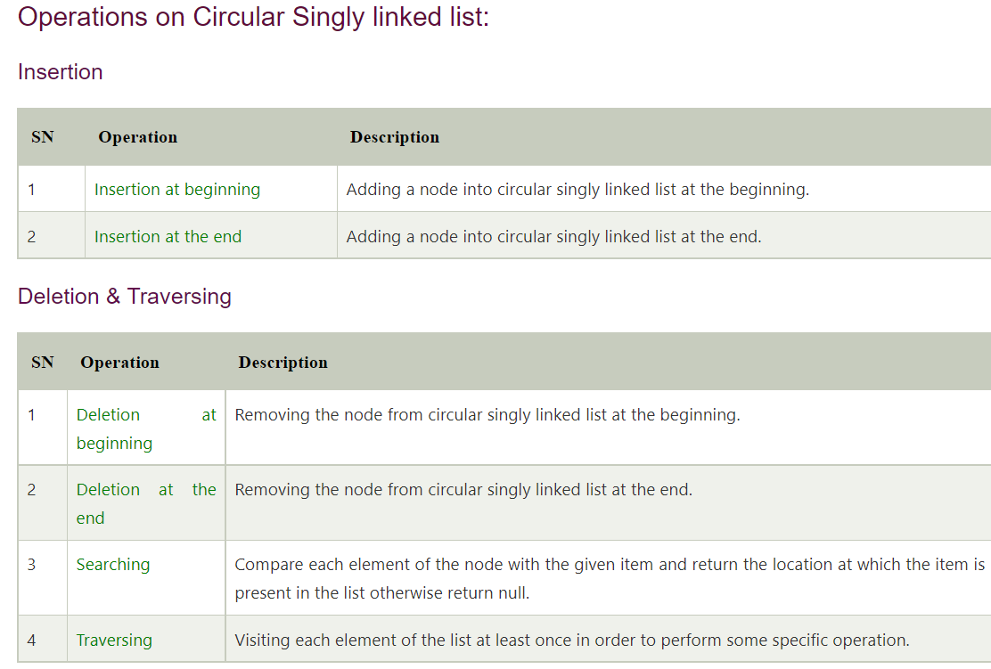
Circular Linked Lists

Slide 74
Circular Linked Lists
Program of CLL

Slide 75
Chapter 3 Stacks and Queues
The Stack Abstract Data Type
The Queue Abstract Data Type

Slide 76
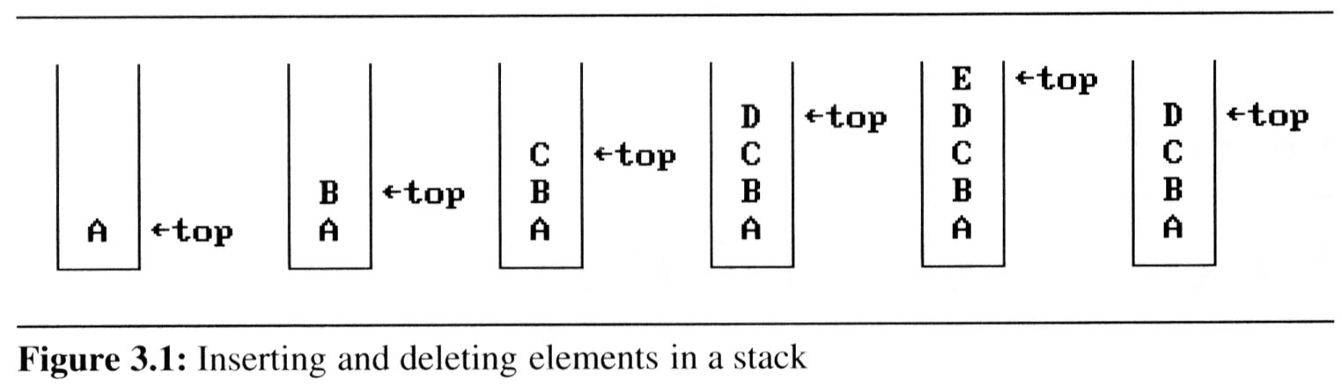
The stack ADT
A stack is an ordered list in which insertions and deletions are made at one end called the top.
If we add the elements A, B, C, D, E to the stack, in that order, then E is the first element we delete from the stack
A stack is also known as a Last-In-First-Out (LIFO) list.

Slide 77
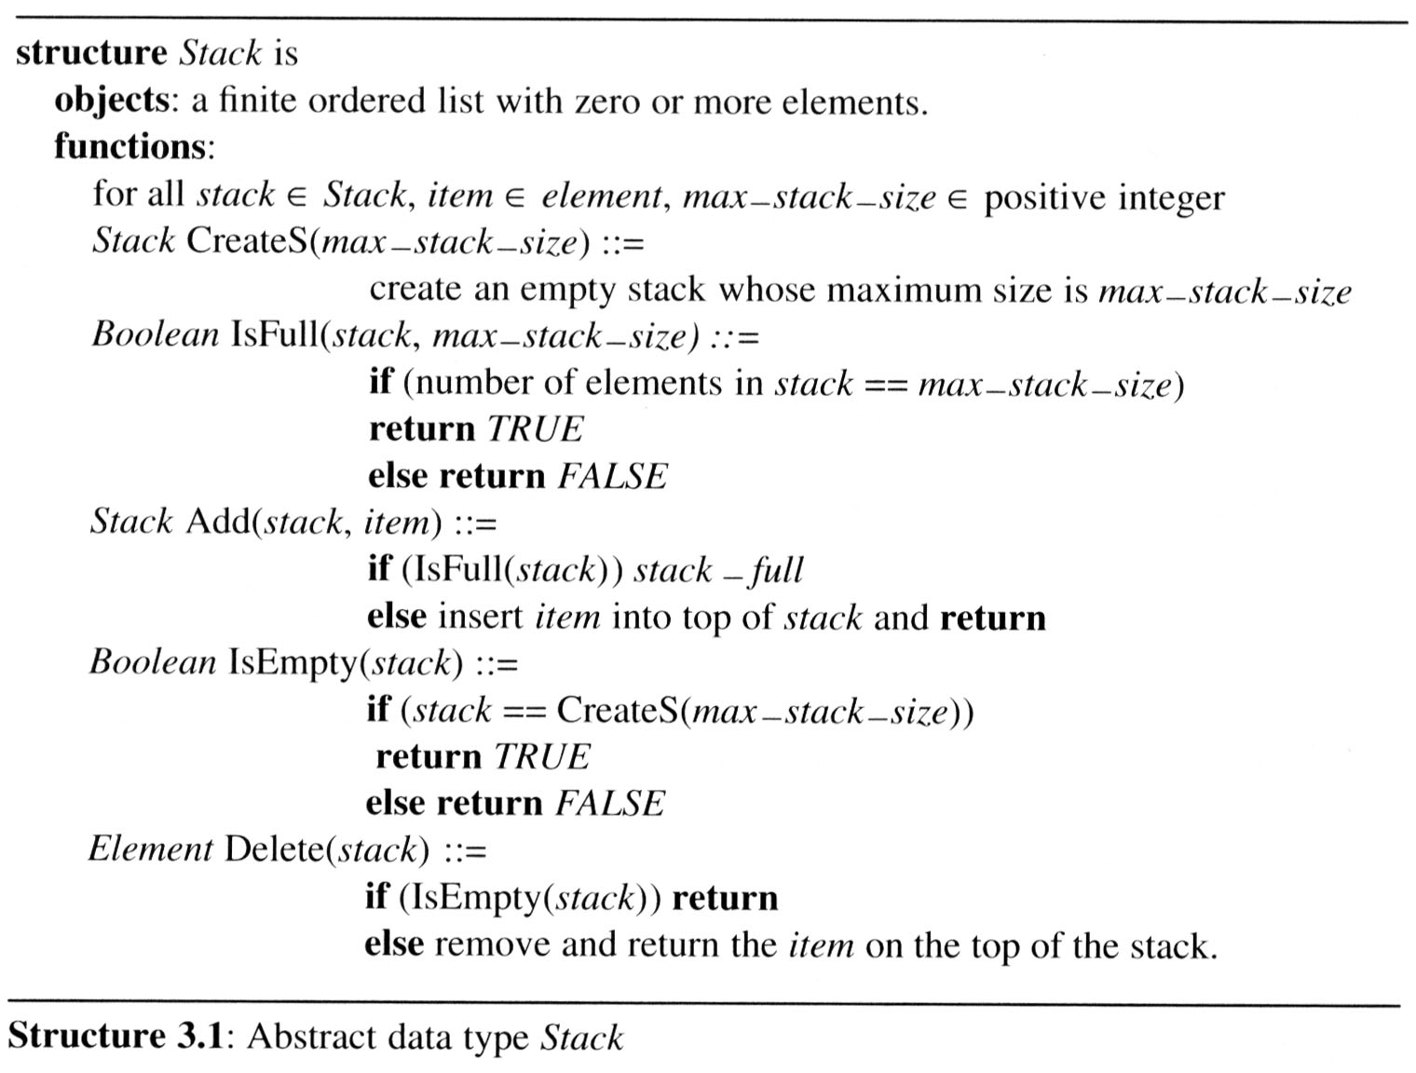
The stack ADT
The ADT specification of the stack is shown in Structure

Slide 78
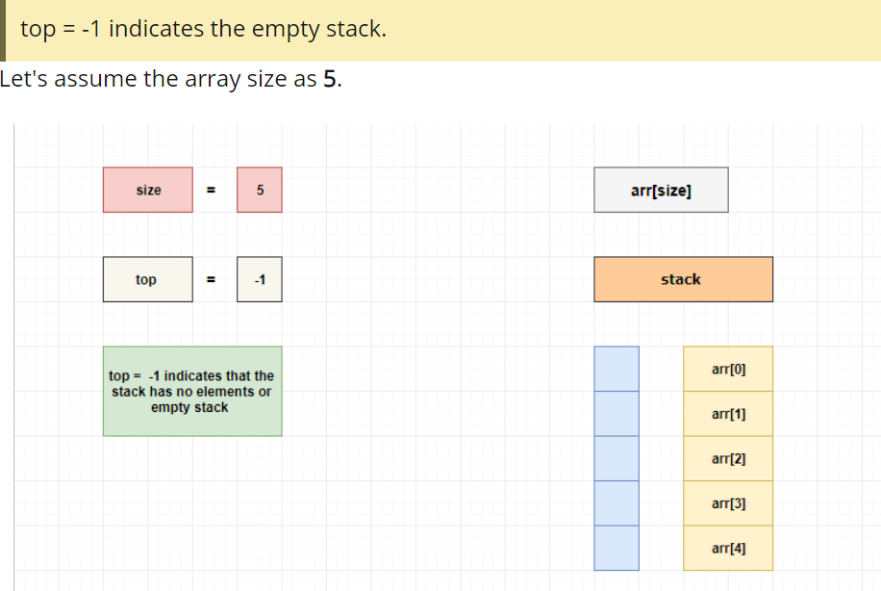
Stack Implementation using Array
Implementation: using array

Slide 79
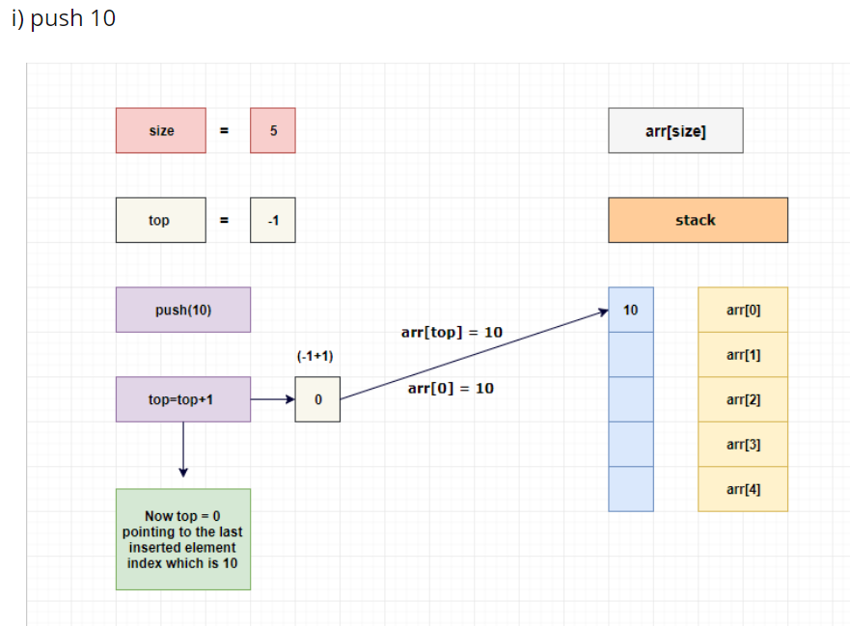
Stack Implementation using Array
Implementation: using array

Slide 80
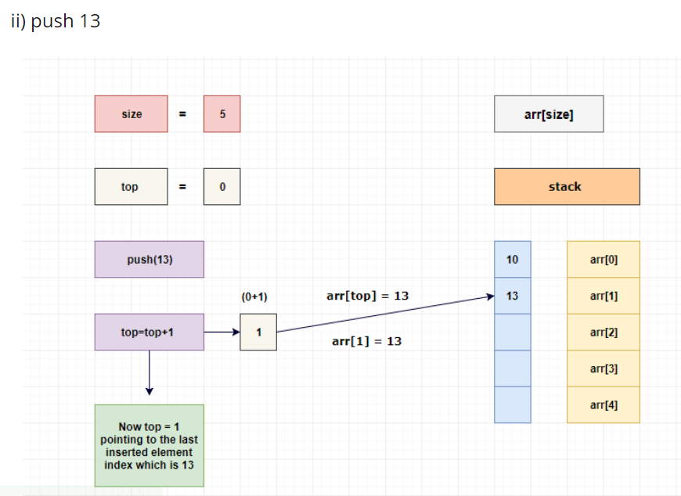
Stack Implementation using Array
Implementation: using array

Slide 81
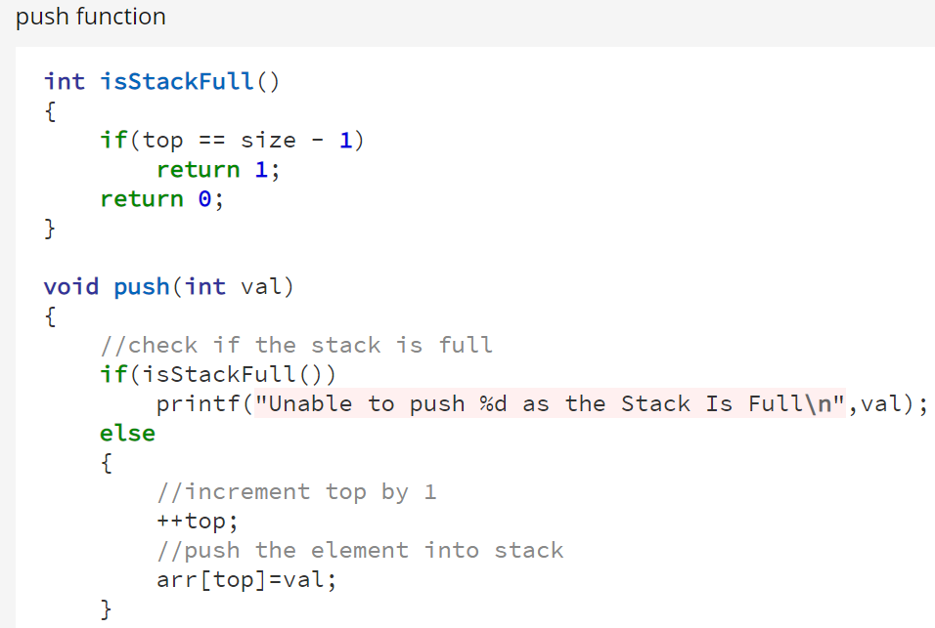
Stack Implementation using Array

Slide 82
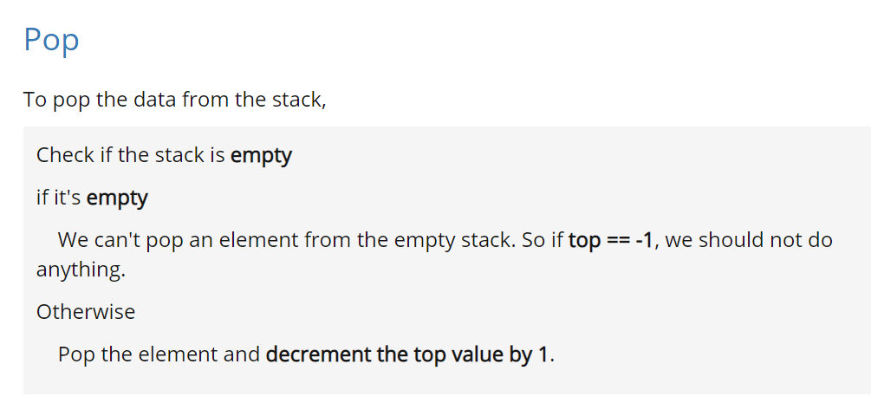
Stack Implementation using Array

Slide 83
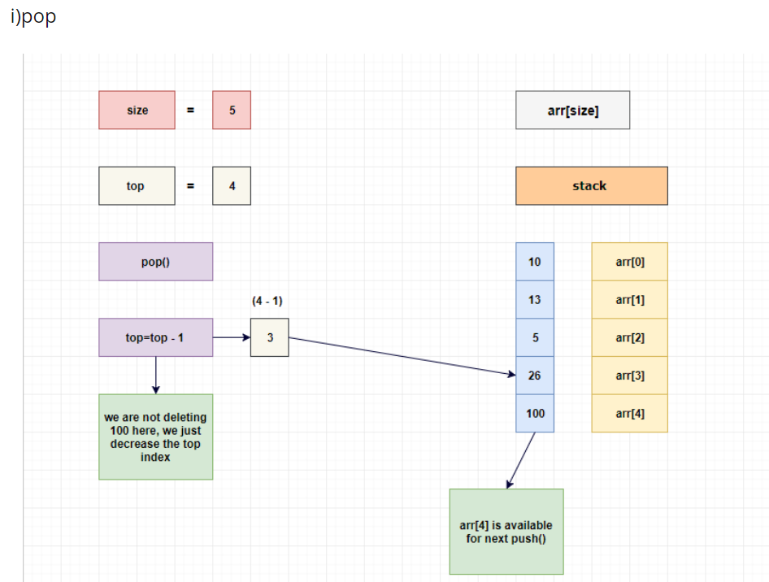
Stack Implementation using Array

Slide 84

Stack Implementation using Array

Slide 85

The queue ADT
A queue is an ordered list in which all insertion take place one end, called the rear and all deletions take place at the opposite end, called the front
If we insert the elements A, B, C, D, E, in that order, then A is the first element we delete from the queue
A queue is also known as a First-In-First-Out (FIFO) list

Slide 86

The queue ADT
The ADT specification of the queue:

Slide 87

The queue ADT
Implementation 1: using a one dimensional array and two variables, front and rear

Slide 88

The queue ADT

Slide 89

The queue ADT

Slide 90
The queue ADT

Slide 91

The queue ADT

Slide 92

The queue ADT

Slide 93

The queue ADT

Slide 94

The queue ADT

Slide 95

The queue ADT

Slide 96
The queue ADT
Queue Program

Slide 97
Various Representation of Linear Data Structure
There are two ways to represent a linear data structure in memory,
Static memory allocation
Dynamic memory allocation
Static memory allocation- In Static data structure the size of the structure is fixed. The content of the data structure can be modified but without changing the memory space allocated to it.
Example of Static Data Structures: Array
Dynamic memory allocation-
In Dynamic data structure the size of the structure in not fixed and can be modified during the operations performed on it. Dynamic data structures are designed to facilitate change of data structures in the run time.
Example of Dynamic Data Structures: Linked List

Slide 98


Slide 99
Operations on linear data Structure
The basic operations that are performed on data structures are as follows: Insertion: Insertion means addition of a new data element in a data structure. Deletion: Deletion means removal of a data element from a data structure if it is found. Searching: Searching involves searching for the specified data element in a data structure. Traversal: Traversal of a data structure means processing all the data elements present in it. Sorting: Arranging data elements of a data structure in a specified order is called sorting. Merging: Combining elements of two similar data structures to form a new data structure of the same type, is called merging.

Slide 100
Applications of linear data structure
Linked list are usually a basic dynamic data structure which implements queues and stacks
In web-browsers, where it creates a linked list of web-pages visited, so that when you check history (traversal of a list) or press back button, the previous node's data is fetched.
To reverse a word. You push a given word to stack - letter by letter - and then pop letters from the stack.
An "undo" mechanism in text editors; this operation is accomplished by keeping all text changes in a stack. - Undo/Redo stacks in Excel or Word.
Language processing : -compiler's syntax check for matching braces is implemented by using stack.
Support for recursion -Activation records of method calls.

